Slide 1

Autism and War in Ukraine
Inna Sergiyenko

Slide 2

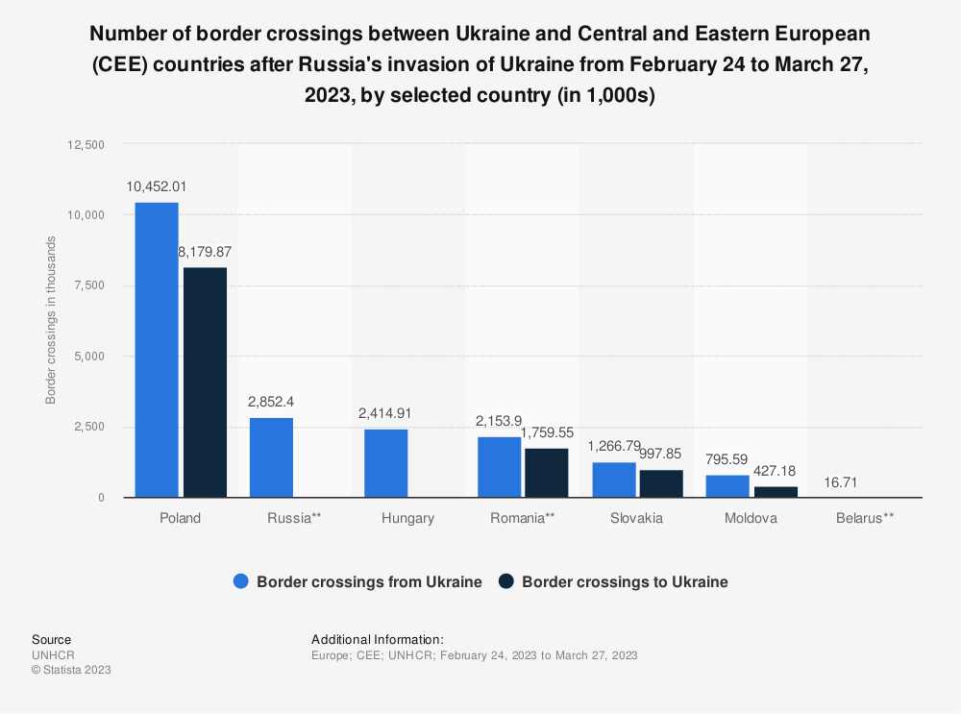

Ukraine situation
specialists who have permanently left Ukraine
displaced families
displaced centres
universal lack of income
broken families
  husbands on the frontlines, or dead, or POW

Slide 3
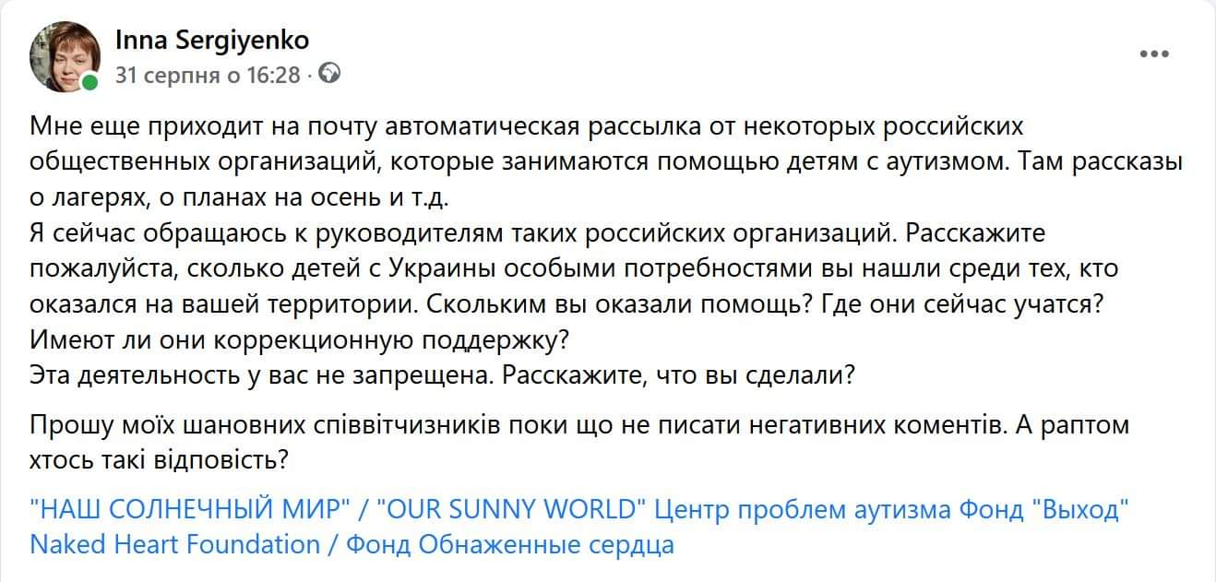
Russian Kidnapping
I still receive automatic emails from some Russian public organizations that help children with autism. There are stories about camps, plans for autumn, etc.
I am now addressing the leaders of such Russian organizations. Please tell me how many children with special needs from Ukraine you found among those who ended up on your territory. How many did you help? Where do they study now? Do they have corrective support? This activity is not prohibited for you. Tell me what you did?
I ask my esteemed compatriots not to write negative comments for now. What if someone answers like this?
“OUR SUNNY WORLD”, Centre for Autism Problems, “Vyhod” Foundation, Naked Heart Foundation

Slide 4








SURVEY RESULTS
THE YEAR OF THE TERRIBLE WAR.
THE EXPERIENCE OF AUTISTIC UKRAINIANS ABROAD
SURVEY RESULTS
2023, spring

Slide 5


SURVEY RESULTS
THE YEAR OF THE TERRIBLE WAR. THE EXPERIENCE OF AUTISTIC UKRAINIANS ABROAD
ABOUT SURVEY
In March-April 2023, the “Child with Future” Foundation conducted “The Year of the Ter- rible War. Experience of autistic Ukrainians abroad” survey.
homes and Ukraine in the first weeks of the
war.
We are sincerely grateful to the governments, civil society organizations and ordinary citi- zens of each country that has become a sec- ond home for Ukrainians and a safe haven from the horrors of the war started by Russia in Ukraine.
The aims of the survey were to understand how Ukrainian families with autistic children who have been living in the EU for a long time assess the provision of special needs of their children abroad; what challenges and opportunities they faced during the refugee crisis, etc.
We would also like to thank the participants of the survey and wish them good health, prosperity and a speedy victory for Ukraine!
The survey was conducted through an online questionnaire. More than 70 families took part in the survey, mostly from the eastern and central regions of Ukraine and Kyiv re- gion. All of them were forced to leave their
We hope that this information will be use- ful for all stakeholders concerned with the mental and psychological health of children.
5

Slide 6
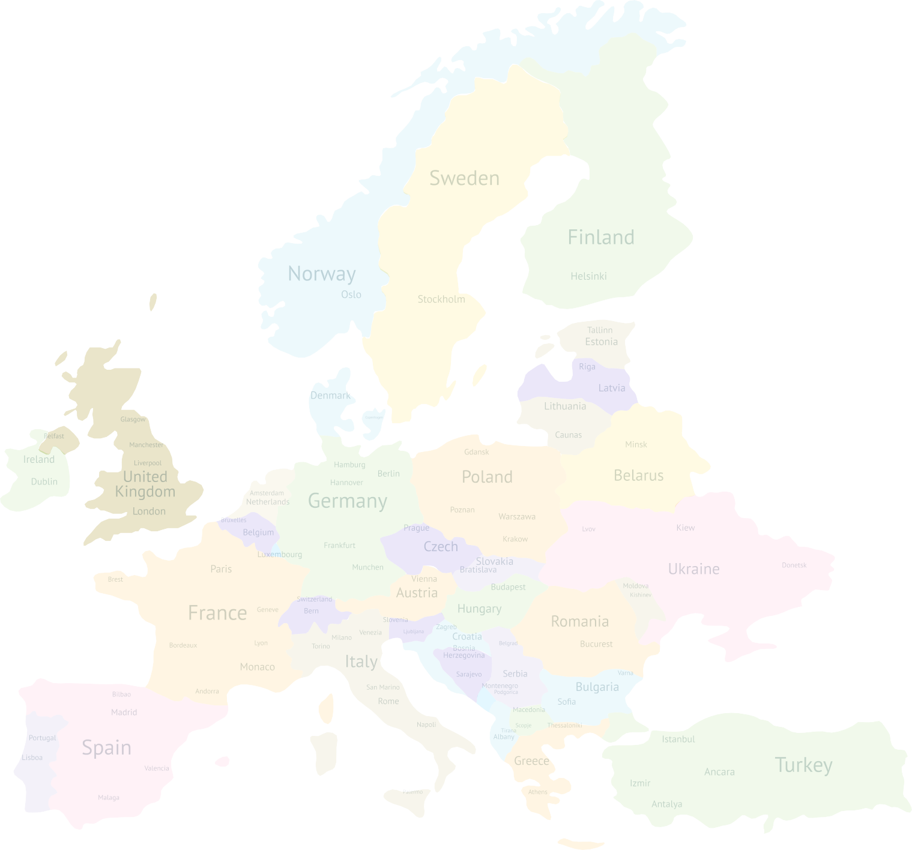


SURVEY RESULTS
THE YEAR OF THE TERRIBLE WAR. THE EXPERIENCE OF AUTISTIC UKRAINIANS ABROAD
SURVEY RESPONDENTS
14,8 %
Country of residence today:
85,2 %
parents
professionals
4,7 %
14,3 %
19 %
4,8 %
Estonia - 7%
Age of the child:
Latvia - 6%
26,6 %
30,6 %
Ireland - 14%
Netherlands - 5%
Poland – 24%
Great Britain – 6%
Germany – 18%
Czech Republic – 7%
0-3 4-6 7-10 11-14 15-18 Older
7 %
4 %
18 %
When did you leave your place of residence and the borders of Ukraine?
Italy - 13%
71 %
Spain - 7%
February-2023
March-2023
spring-2023
in the summer of -2023
UNITED ARAB EMIRATES - 3%
6

Slide 7
SURVEY RESULTS
THE YEAR OF THE TERRIBLE WAR. THE EXPERIENCE OF AUTISTIC UKRAINIANS ABROAD
1. What factors were the biggest challenge for your family in Ukraine after the decision to evacuate abroad (%)?
Psychological
19,2 %
71,2 %
9,6 %
Uncertainty of the future
27,6 %
67,6 %
4,8 %
Inability to plan
14,3 %
19,2 %
66,5 %
Disappearance of services and professionals for children
27,3 %
49,3 %
23,4 %
Logistical problems
37 %
48,9 %
14,1 %
Financial issues
34 %
46,7 %
19,3 %
Problems with medicines
32,2 %
38,6 %
29,2 %
Lack of information
28,5 %
57,2 %
14,3 %
Problems with feeding
12,6 %
63,1 %
24,3 %
Bureaucratic barriers
9,5 %
58,3 %
32,2 %
0,0 %
10,0 %
20,0 %
30,0 %
40,0 %
50,0 %
60,0 %
70,0 %
80,0 %
High level
Medium level
Low level
Additional challenges mentioned by people:
“fear of death”, “sitting in the basement”, “sleeping in the corridor”, “fear for the child’s life and my own”.
7

Slide 8
SURVEY RESULTS
THE YEAR OF THE TERRIBLE WAR. THE EXPERIENCE OF AUTISTIC UKRAINIANS ABROAD
2. Which challenges were the biggest for your family abroad in the first months of stay (%):
Psychological
32,4 %
76 %
5 %
Lack of professionals for the child
19 %
71,5 %
9,5 %
Lack of information on child support
20,3 %
67,6 %
12,1 %
Language barrier
32,5 %
54,2 %
14,3 %
Local bureaucracy
35,4 %
53,6 %
11 %
Shortage of child support staff
34 %
43,5 %
22,5 %
Access to medicines and medical services
22,7 %
43,3 %
34 %
Financial issues
36,2 %
39,8 %
24 %
Living conditions
33 %
_{33 %} 34 %
Cultural and social differences
19,7 %
70,8 %
9,5 %
0,0 %
10,0 %
20,0 % 30,0 %
Medium level
40,0 %
50,0 %
60,0 %
70,0 %
80,0 %
High level
Low level
The 11th place was taken by the “Food” factor with indicators of 38.8, 41.6, and 19.6, respectively.
8

Slide 9
Ukrainian autistic students
Different school culture, rules and expectations
Different language
Scared to “lose a year”
Lingering trauma and anxieties
  Fire alarms
  Discussion and essay topics, eg “how I spent my summer”
  Refusal to participate because they want to “go home”
Russian students

Slide 10
SURVEY RESULTS
THE YEAR OF THE TERRIBLE WAR. THE EXPERIENCE OF AUTISTIC UKRAINIANS ABROAD
3. Have you noticed any changes in your child’s condition over the past year? What kind of changes?
Anxiety
52,4 %
Progress
47,7 %
Regression
29,6 %
Sleep disorders
27,9 %
Eating disorders
23,8 %
Reversal in skills
19 %
Some changes for the better
6 %
Worsening of mental state
5,4 %
Withdrawal, unwillingness to interact with peers
5 %
No changes
4,8 %
0,0 %
10,0 %
20,0 %
30,0 %
40,0 %
50,0 %
60,0 %
The 11th place was taken by the “Language problems” challenge with 4.1%.
10

Slide 11
As a result, autistic people are:
traumatised
often do not have access to trauma-informed care
new anxieties, depression and other mental health concerns
regression
many have refused to accept the new situation abroad and want to return home, even if their house has been destroyed
progress in independence accompanied by health problems

Slide 12
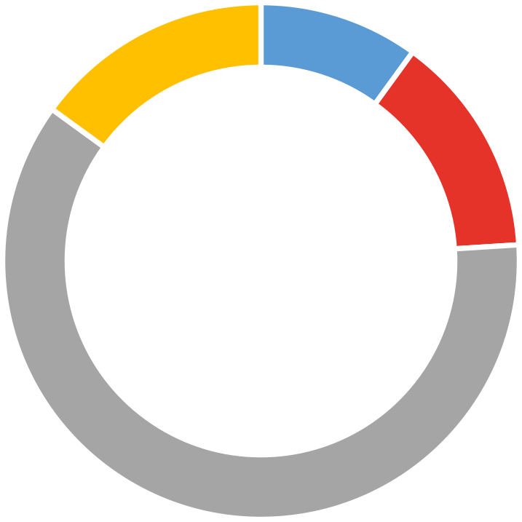
SURVEY RESULTS
THE YEAR OF THE TERRIBLE WAR. THE EXPERIENCE OF AUTISTIC UKRAINIANS ABROAD
SURVEY RESULTS
4. How long did it take you to more or less adapt in another country so that you and your child felt relatively comfortable?
15 %
10 %
14 %
61 %
1 month
2-3 months
5-6 months
More time is needed for this
7

Slide 13
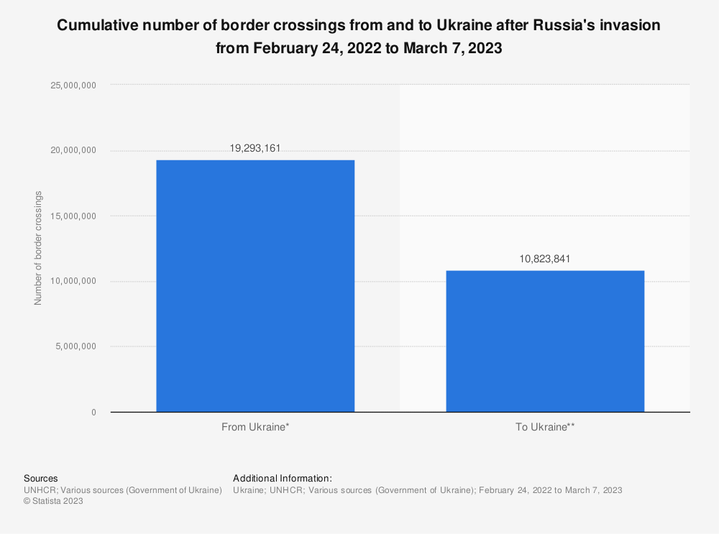
Feedback from families abroad:
navigating foreign bureaucracy in a foreign language is a struggle
some found available services insufficient and have returned to Ukraine
are very grateful to host families, but struggle with not being a burden on their hosts, especially when it comes to their child's behaviour

Slide 14
SURVEY RESULTS
THE YEAR OF THE TERRIBLE WAR. THE EXPERIENCE OF AUTISTIC UKRAINIANS ABROAD
5. How would you assess the level of development and functioning of the following areas on which support for an autistic child in Ukraine depends at the time of your forced refugee status (%)?
Professional level of staff
24,5 %
32 %
43,5 %
Cost of medical services
27,4 %
38,6 %
34 %
Availability of infrastructure for working with autistic children
17,6 %
34 %
48,4 %
Communication with peers and friends
23,5 %
33,5 %
34 %
Accessibility of services for autistic children
28,6 %
32,6 % _{38,8 %}
Cost of services for autistic children
28,4 %
43,4 %
29,2 %
Attitudes of society towards autistic children in everyday life
26,8 %
34,4 %
38,8 %
The level of support from compatriots
24,2 %
30 %
45,8 %
Accessibility of medical services
22,4 %
58,4 %
19,2 %
Readiness of educational centers to work with autistic children
17,3 %
43,9 %
38,8 %
0,0 %
10,0 %
20,0 % 30,0 %
40,0 %
50,0 %
60,0 %
70,0 %
High level
Medium level
Low level
* - answers are arranged in descending order of “high” scores.
The 11th place was taken by “Municipal support” (19.2 - 72 - 8.8). The 12th place was taken by “State support” (33.2 - 62.8 - 4).

Slide 15
SURVEY RESULTS
THE YEAR OF THE TERRIBLE WAR. THE EXPERIENCE OF AUTISTIC UKRAINIANS ABROAD
6. How would you assess the level of development and functioning of the following areas, on which support for an autistic child depends, during the period of residence in the host country (%)?
Public attitudes towards autistic children in everyday life
9,7 %
86,3 %
4 %
Municipal support
27,9 %
73,1 %
10 %
State support
19,8 %
70,5 %
9,5 %
Readiness of educational organizations to work with autistic children
31,2 %
57,8 %
11 %
Availability of infrastructure for working with autistic children
36,6 %
49,1 %
14,3 %
Accessibility of medical services
36,5 %
43,3 %
20,2 %
Communication with peers and friends
39,4 %
47,6 %
13 %
Professional level of staff
37,2 %
58 %
4,8 %
The level of support from compatriots
_{29 %} 33,8 %
37,2 %
Cost of services for autistic children
36,8 %
54,2 %
9 %
0 %
10 % 20 %
Medium level
30 % 40 %
Low level
50 %
60 %
70 %
80 %
90 % 100 %
High level
* - answers are arranged in descending order of “high” scores.
The 11th place was taken by “Cost of medical services” (12 - 60.3 - 27.7).
The 12th place was taken by “Availability of services for work with autistic children” (10.2 - 66 - 23.8).

Slide 16
SURVEY RESULTS
THE YEAR OF THE TERRIBLE WAR. THE EXPERIENCE OF AUTISTIC UKRAINIANS ABROAD
7. Has your assessment of the current system of support for children with special needs in Ukraine changed over the past year?
8. Has your assessment of the current system of support for children with special needs in a for- eign country changed over the past year?
27,8 %
27,8 %
22,2 %
38,9 %
33,3 %
50 %
has not changed
has not changed
In general, it has changed for the better
In general, it has changed for the better
In general, it has changed for the worse
In general, it has changed for the worse
9. What factors remain the most sensitive for you in your host country today? Name three main ones.
Financial instability.
Healthcare*.
Language barrier.
* - this item has a wide meaning, it includes (to quote): “therapy for a child”, “seriously limited access to professionals”, “limited access to medicines”, “lack of timely medical care”, “medical bureaucracy”.

Slide 17
THE YEAR OF THE TERRIBLE WAR. THE EXPERIENCE OF AUTISTIC UKRAINIANS ABROAD
10. Name the three main advantages in autism that you see and feel in your country of
current residence compared to Ukraine:
State support is sustainable, structured and systematic.
Tolerance of society and establishments.
Developed infrastructure for children.
11. What are the three main advantages of Ukraine on autism that you realized during your stay in the country of current residence?
12. Are you going to return to Ukraine and when are you going to return?
10,5 %
in the near future
A wider range of medical and educational services.
Availability of good specialists and information.
Inclusion in schools.
after the final victory of Ukraine
26,3 %
after the conditions for living with an autistic child are restored
we have decided not to return
The vast majority of respondents also mentioned the “home factor”. 8% said they could not name any advan- tages.
52,6 %
5,5 %
it is difficult to say anything for sure now
5,1 %

Slide 18
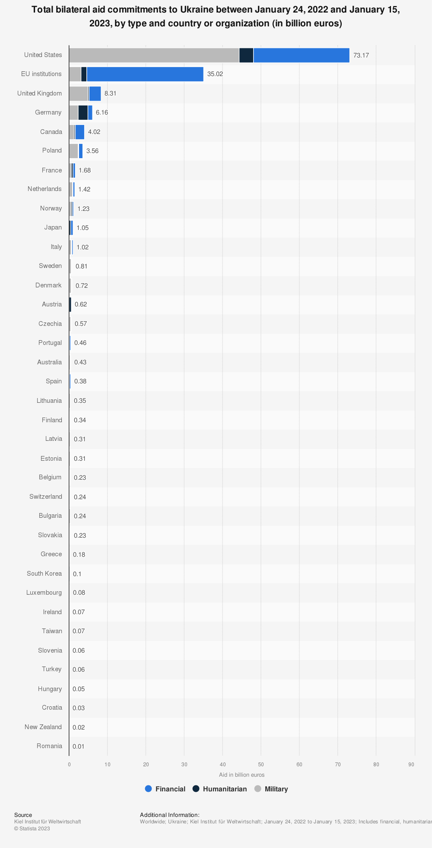
Future:
as donations come in, we need to remain vigilant about scammers - already there are people claiming to be experts just to get donation money.

Slide 19
Our work during the war:
У МОЄЇ ДИТИНИ АУТИЗМ
ПЕРШІ КРОКИ ДОПОМОГИ
Organised information support network in the first days
  Both internal and international level
Helping centres relocate from occupied regions
Carried on consultations and support via telehealth
Renewed preschool and sports services for autistic children and teens in person
Organised two conferences: for parents and for pediatricians
Organising delivery of autism-related humanitarian aid to families in need
Charity auctions of paintings by autistic author
Ongoing best practices podcast
Spreading awareness about war trauma and autism
Lectures for parents in collaboration with Stanford university
Collecting donations to keep these projects going!
donorbox.org/helpautismukraine
cwf.com.ua/en

